Slide 1
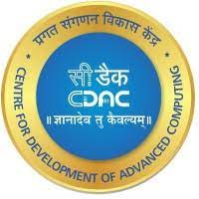

CI/CD Pipeline using Jenkins and infusing security by performing code quality analysis.
Presented by:
Anita A Khamitkar
Ankush Kapoor
Kamble Rohini Mahendra Kumar Pankaj
Numesh Kumar Sahare
Guided by:
Mr. Ashutosh Das

Slide 2
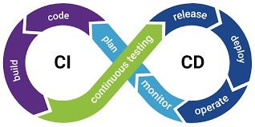
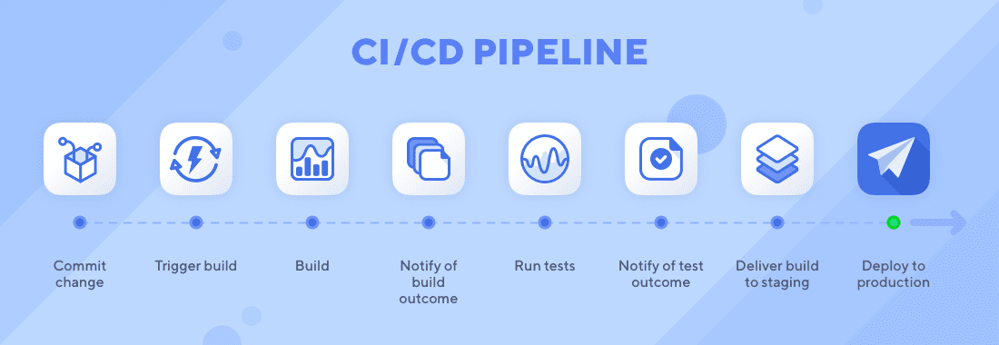
Introduction
Continuous Integration and Continuous Delivery (CICD) pipeline approach has increased the efficiency of projects.
The project will utilize best practices and industry standards to ensure that code is continuously integrated, tested, and deployed in a secure manner.
The pipeline will consist of several stages, including source code management, build, automated security testing, and deployment.

Slide 3
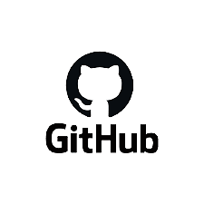
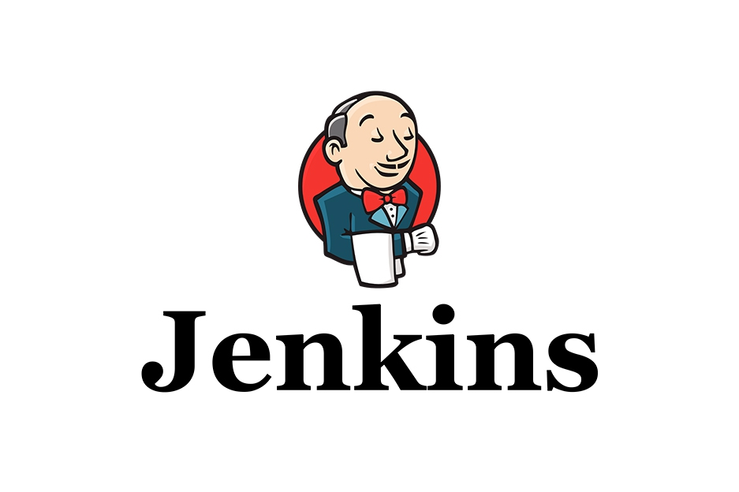


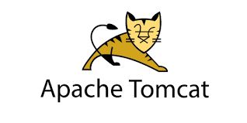
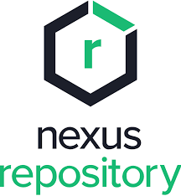
Work-Flow
Developer
Code Commit
Clone GIT Repo
Build as Global Tool
Developer
Code Review
Deployment
Uploading Artifacts

Slide 4
What We Are Trying To Do ?
The Project involves the creation of a complete pipeline solution using Jenkins and other related tools such as Git, SonarQube, Nexus and Tomcat server.
The Project will automate the entire development process from code development, build, to code quality analysis and deployment.

Slide 5
Why Jenkins ?
Jenkins is a popular open-source automation server.
Jenkins has easy installation, configuration, rich plugin availability, extensibility, and distributed builds for different computers.
Its ease of integration with other tools makes deployment seamless.
Jenkins offers continuous integration services for different languages and source code repositories using pipelines.
Provide real-time feedback on the status of each stage in the pipeline.
It can also be configured to send notifications and alerts to team members when a build fails or when an issue is detected.
Alternative tools: CircleCI, TeamCity, Bamboo, GitLab, etc.

Slide 6
Role of Github in this project.
The GitHub repository is integrated with our Jenkins project.
With this Jenkins GitHub integration, we or developers can now use any file found in the GitHub repository and trigger the Jenkins job to run with every code commit.
GitHub CI/CD allows developers to make changes to their codes frequently.
We can update them in production once the code is approved rather than waiting for a release.
This ability of GitHub accelerates the speed of code deployment.
Alternative tools: GitLab,Bitbucket,Launchpad, SourceForge, Beanstalk etc.

Slide 7
What is Maven doing here?
Maven is build tool that uses a POM (project object model) to helps build process through plugins.
A POM is the core of a project's configuration in Maven. It’s an XML file containing info about the project, configuration details, and default values for most projects.
Maven helps developers maintain Java-based applications through projects that organize code files and build scripts to run compiler tools, version numbers for compiled code, and dependency management that lets one project reference a version of another project.
Jenkins allows you to run Maven, and decide when to call a POM file, what condition to call, and what to do with the outcome.
Installing Maven plugin in Jenkins will add a "Build" section to your projects where you can specify exactly what to execute.
Alternative tools: Red Hat Ansible Automation Platform, Azure DevOps Server,Postman etc.

Slide 8
Does SonarQube ensures the Quality of Code ?
SonarQube can be used to analyse code for bugs, security vulnerabilities, and code smells.
It can also measure code complexity and maintainability, providing developers with insights on how to improve the overall quality of their code.
SonarQube can also be configured to enforce certain quality standards and best practices, such as adherence to coding conventions or specific security guidelines.
It combines static and dynamic analysis tools and enables quality to be measured continually over time.
SonarQube scanner performs code analysis based on a set of rules for the current programming language. This tool comes with a predefined set of rules, which can be modified and expanded according to the project needs.
Alternative tools:Veracode, FindBugs, ReSharper, etc.

Slide 9
Use of NEXUS
Nexus by Sonatype is a repository manager that organizes, stores and distributes artifacts needed for development.
With Nexus, developers can completely control access to, and deployment of, every artifact in an organization from a single location, making it easier to distribute software.
Using a Nexus server in a CI/CD pipeline provides several benefits, including:
Centralized artifact management: All artifacts produced by the pipeline are stored in a central location, making it easy to manage and share them across different stages of the pipeline.
Improved build performance: The Nexus server caches artifacts, reducing build times and improving performance.
Greater control and security: The Nexus server provide access control, ensuring that only authorized users can access and modify artifacts.
Alternatives: Nuget, ProGet, Amazon ECR, etc.

Slide 10
Deployment in TomCat Server.
Tomcat is an open-source and powerful servlet Java container for running web applications.
It is the most widely used web server, in which we have to move the . war file to the /webapps directory.
Then Tomcat will install the . war file automatically and deploy the application.
This creates a unified experience, which is easier to manage.
By default, tomcat runs on port 8080.
Alternative tools: AWS Lambda, Salesforce Lightning Platform, WebLogic Server, etc.

Slide 11
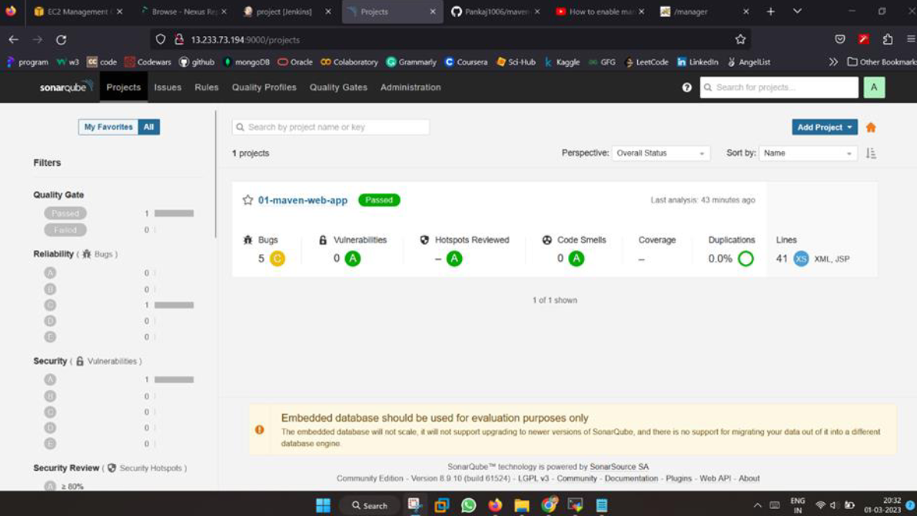
Project Snapshots
Report Generation in SonarQube server Dashboard on successful scanning performed by Sonar Scanner

Slide 12
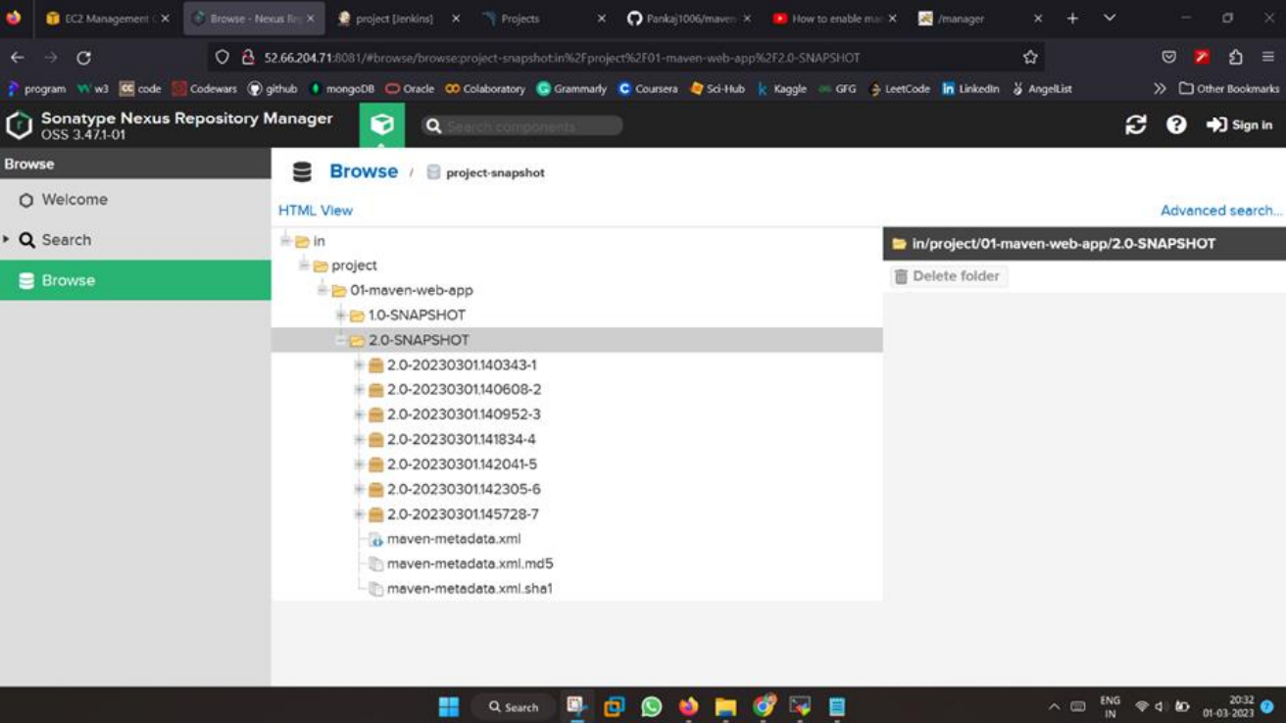
Artifacts are uploaded as war file on build and version change.

Slide 13
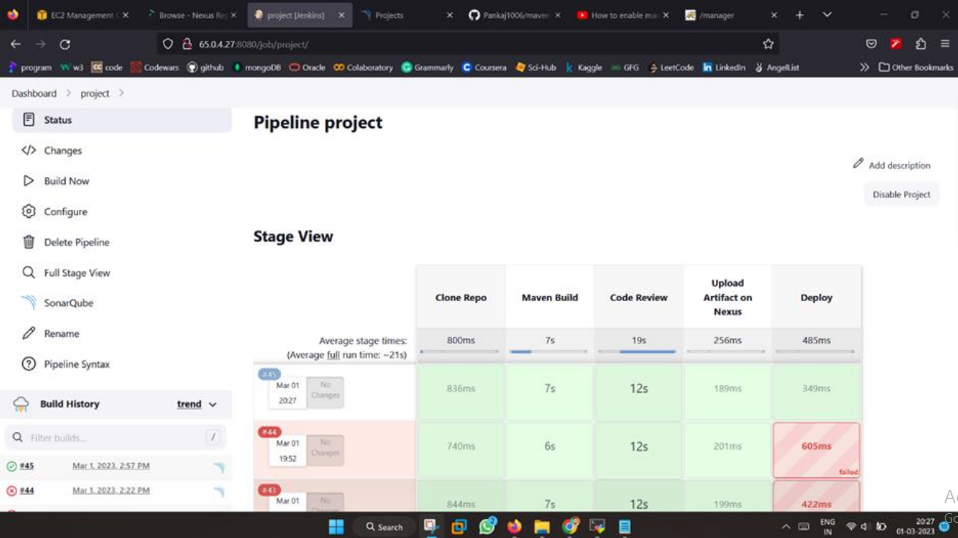
Green colour marks and signifies that the build is successful and pipeline is working properly without any interruption and with secure code.

Slide 14
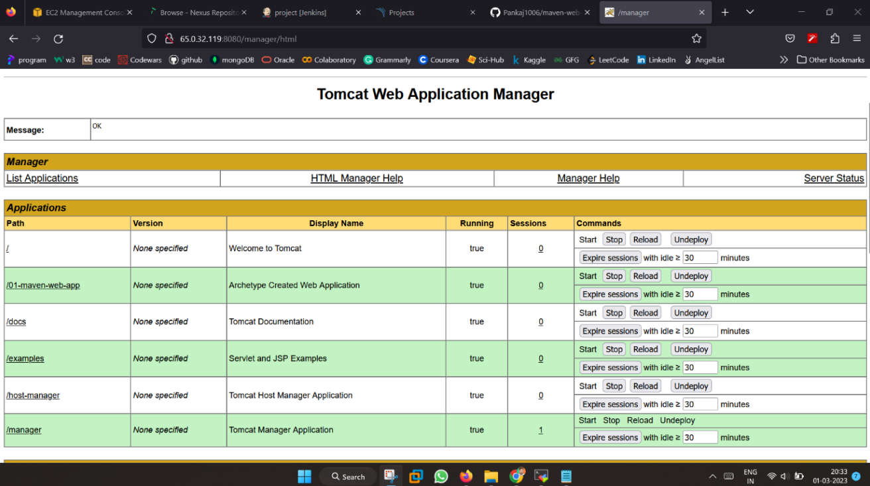
Deployment is done on Tomcat server

Slide 15
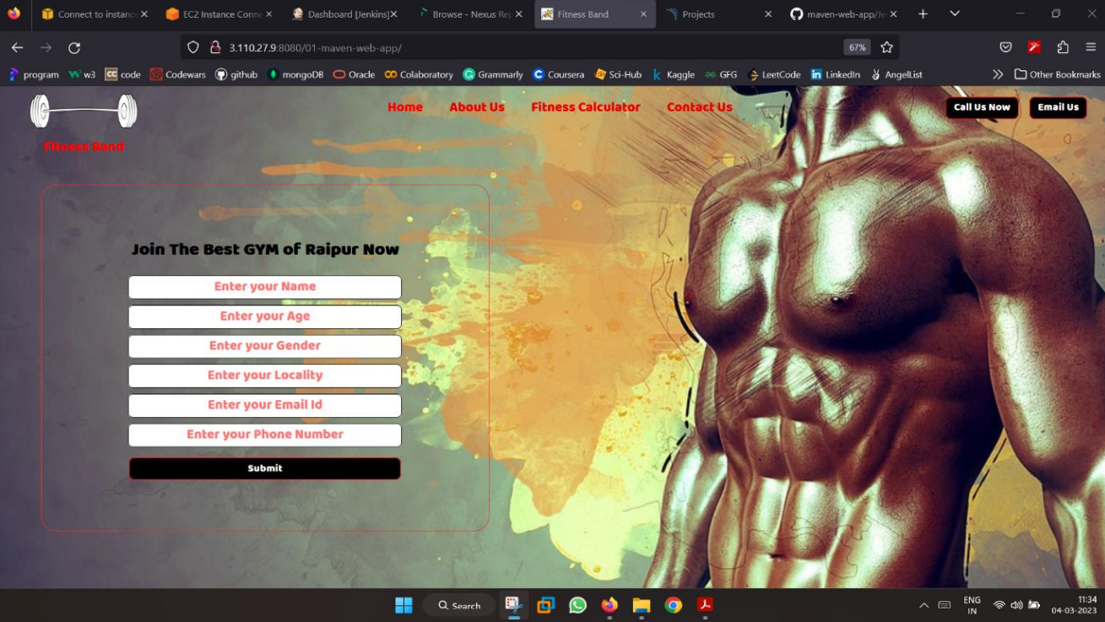
Sample website output hosted on Tomcat Server after the successful build of pipeline.

Slide 16
Conclusion
In conclusion, implementing a CI/CD pipeline using Jenkins, SonarQube, Nexus, and Tomcat server can greatly improve software development processes by automating the build, test, and deployment processes, while also providing continuous feedback on code quality and security.
By integrating these tools into a CI/CD pipeline, developers can ensure that code changes are thoroughly tested before being deployed, and that any issues are identified and addressed early in the development process.
This can help to improve the quality of the application and reduce the risk of issues arising in production.

Slide 17
Future Scope
We can also do the same CI/CD process with the help of following tools:
The pipeline begins with a Git clone step, where the source code is pulled from a repository and made available for further processing.
The next step is to use Git secret to scan the codebase for secrets and sensitive information.
Trufflehog is then used to detect and report any known vulnerabilities in the codebase.
Hadolint is then used to check the codebase for any errors or issues in the Dockerfiles.
Maven/NPM build is used to build the application and ensure that it is ready for deployment.
NPM unit test cases are then executed to test the application and ensure that it meets the required quality standards.
Docker build can be used to build a container image of the application, which is then pushed to a container registry. Dependency-check is used to analyze the application and identify any known vulnerabilities in its dependencies.
Docker push can be used to push the container image to a container registry.
Trivy can be used to scan the container image for vulnerabilities and report any issues.
We have tried to apply the above process, reference : https://github.com/AnitaPK/taskManager

Slide 18
References and Links:
⦁ Jenkins Documentation for pipeline
https://www.jenkins.io/doc/tutorials/#pipeline
⦁ Reference for SonarQube
https://www.sonarsource.com/products/sonarqube/
⦁ Reference for Nexus
https://www.sonatype.com/products/nexus-repository
⦁ Tomcat Server Documentation
https://tomcat.apache.org/
⦁ References from Git
https://github.com/AnkushKapoor-97/DevOps.git
https://github.com/Pankaj1006/Devops-project-in-AWS.git
⦁ AWS Documentation
https://docs.aws.amazon.com/

Slide 19
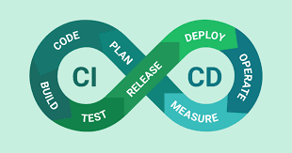
Thank you

